Slide 1

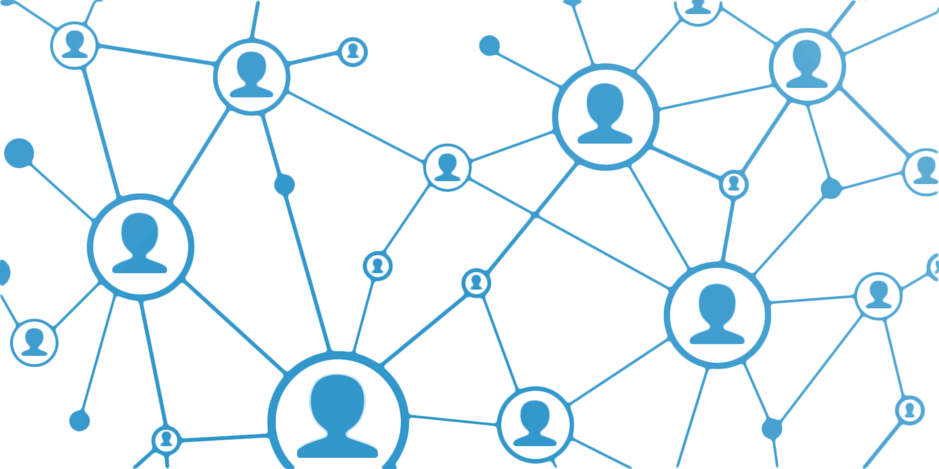
Data Communication
Dr. Vijay Ukani
Associate Professor
Institute of Technology, Nirma University

Slide 2
Contents
Introduction to Data Communication
Network Components
Data Representation
Data Flow
Network Physical Structure
Network Physical Topology

Slide 3

Introduction
Data communications and networking have changed the way we do business and the way we live
Information on fingertips, Google, ChatGPT
Internet applications like YouTube, WhatsApp, Facebook, Instagram etc
Email, File Sharing, ERP

Slide 4
Introduction
When we communicate, we are sharing information.
Sharing can be local (face-to-face) or remote (telecommunication).
The term Telecommunication, which includes telephony, telegraphy, and television, means communication at a distance.
The word Data refers to information presented in whatever form is agreed upon by the parties creating and using the data.
Data communications (DC) are the exchange of data between two devices via some form of transmission medium such as a wired cable or a wireless medium.
Communicating devices must be part of a communication system made up of a combination of hardware (physical equipment) and software (programs)

Slide 5



Introduction Contd..
The effectiveness of a data communications system depends on four fundamental characteristics:
Delivery: Data delivery to the correct destination.
Accuracy: System must deliver the data accurately.
Timeliness: System must deliver data in a timely manner.
Jitter: Refers to the variation in the packet arrival time (uneven delay in delivery).

Slide 6

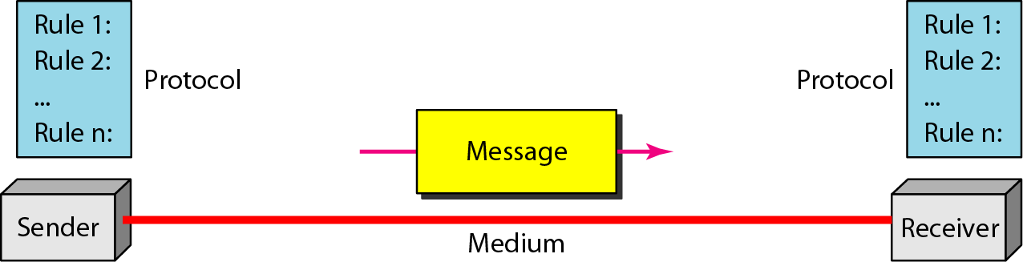





DC/Network Components
Figure: Five components of data communication

Slide 7
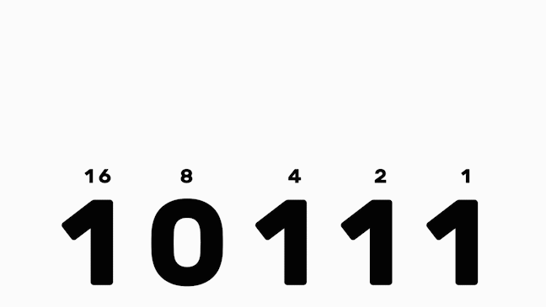
Data Representation
Information today comes in different forms such as text, numbers, images, audio, and video.
Text:
  Sequence of bits (0s or 1s).
  Different sets of bit patterns have been designed to represent text symbols.
  Each set is called a code, and the process of representing symbols is called coding. Code eg Unicode and ASCII
Numbers:
  Numbers are also represented by bit patterns.

Slide 8
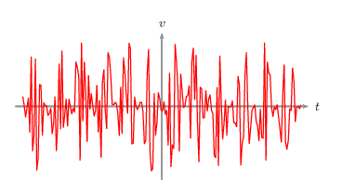

Data Representation
Images:
  Images are also represented by bit patterns.
  Composed of a matrix of pixels. Each pixel represented by bit pattern
  Monochrome image pixel represents black or white color. 1-bit is sufficient for each pixel/
  2-bit pattern (00-Black and 11-White) for BW images and RGB/CMY/HSV for coloured images.
Audio:
  Audio refers to the recording or broadcasting of sound or music.
  It is continuous, not discrete.
Video:
  Video refers to the recording or broadcasting of a picture or movie.
  Video can either be produced as a continuous entity, or it can be a combination of images.

Slide 9
Network Communication Protocols
In computer networks, communication occurs between entities in different systems.
However, two entities cannot simply send bit streams to each other and expect to be understood.
For communication to occur, the entities must agree on a protocol.
A protocol is a set of rules that govern data communications.
A protocol defines what is communicated, how it is communicated, and when it is communicated.
The key elements of a protocol are syntax, semantics, and timing.

Slide 10
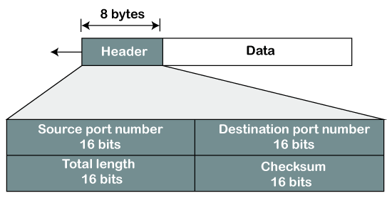
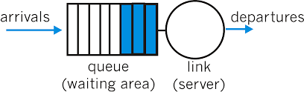
Network Communication Protocols
Syntax: Structure or format of the data.
Semantics: Refers to the meaning of each section of bits.
Timing: When data should be sent and how fast they can be sent. For example, if a sender produces data at 100 Mbps but the receiver can process data at only 1 Mbps, the transmission will overload the receiver and some data will be lost.

Slide 11
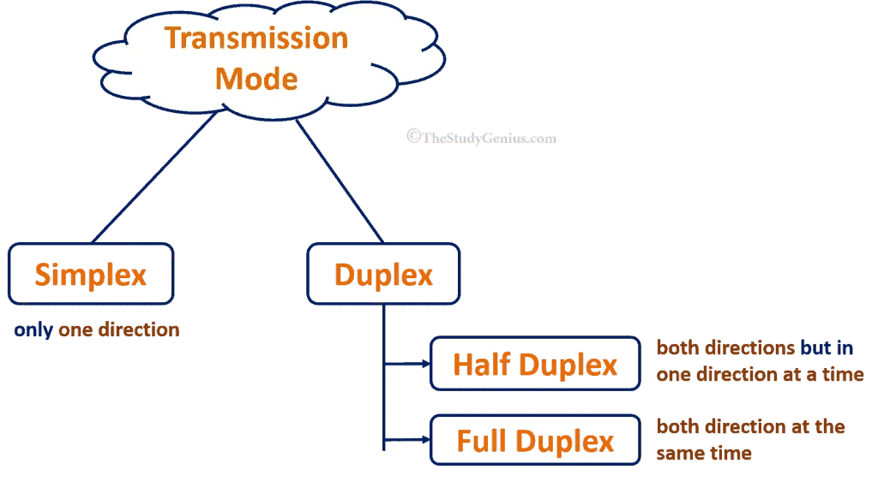

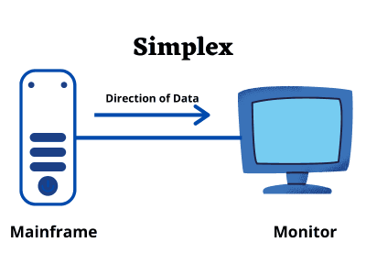
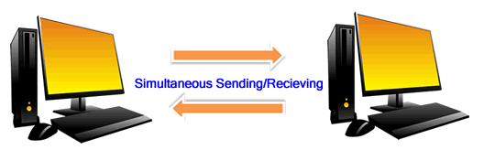
Data Flow
Walkie-Talkie

Slide 12
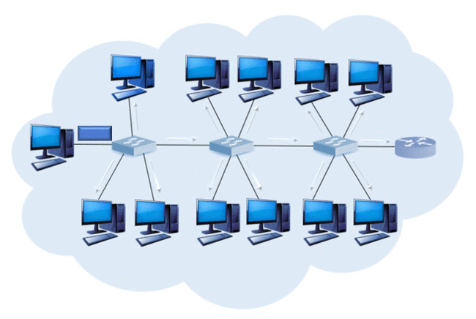
Network
A network is a set of devices (often referred to as nodes) connected by communication links.
A node can be a computer, printer, or any other device capable of sending and/or receiving data generated by other nodes on the network.
Device can be a host or a connecting device, connected using wired or wireless medium.
A network must be able to meet a certain number of criteria (performance, reliability, and security).

Slide 13
Network Criteria
Performance
  Transit time, response time, number of users, type of transmission medium, capabilities of the connected hardware, efficiency of software, throughput, and delay.
Reliability
  Frequency of failure, time taken for a link to recover from a failure, network’s robustness in catastrophe.
Security
  Protecting data from unauthorized access, protecting data from damage and development, implementing policies and procedures for recovery from breaches and data losses.

Slide 14
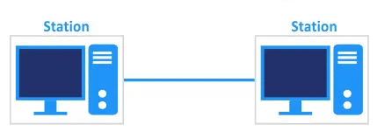
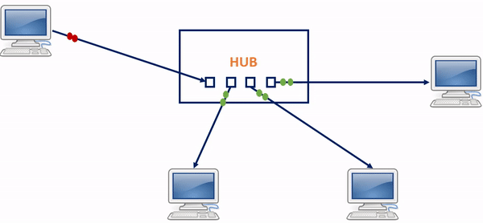
Network: Physical Structures
A network is two or more devices connected through links, so it must have some structure.
Two types of connections
  Point-to-point connection
    Dedicated link between two devices; entire capacity is reserved for the two devices
    Examples:
      A leased line between two offices.
      A direct fiber optic connection between two routers.
  Multipoint connection
    More than two specific devices share same link
    Channel capacity is shared
    Examples:
      A wireless access point serving multiple clients.
      Satellite uplink transmitting to multiple ground stations.

Slide 15
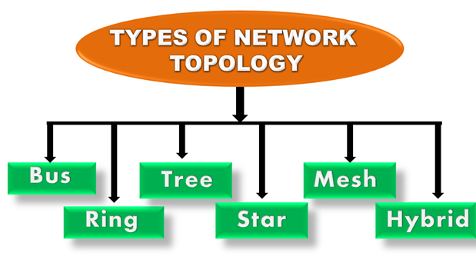
Network: Physical Topologies
Way the network is laid physically.
Geometric representation of the relationship of all links and linking devices (nodes) to one another.
https://static.javatpoint.com/tutorial/computer-network/images/computer-network-topologies.png

Slide 16
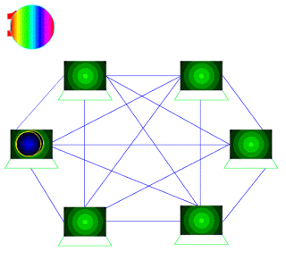
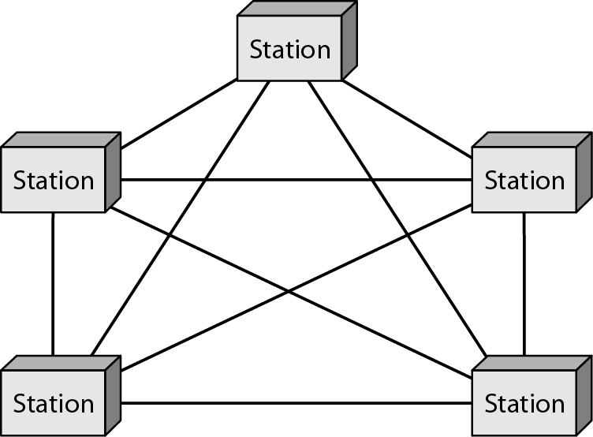
Mesh Topology
Dedicated link to all nodes.
Number of physical links (if n nodes):
  n(n-1) – if simplex mode (two links for up and down)
  n(n-1)/2 – if full-duplex mode
Example: Each telephone regional office is connected to every other regional office

Slide 17
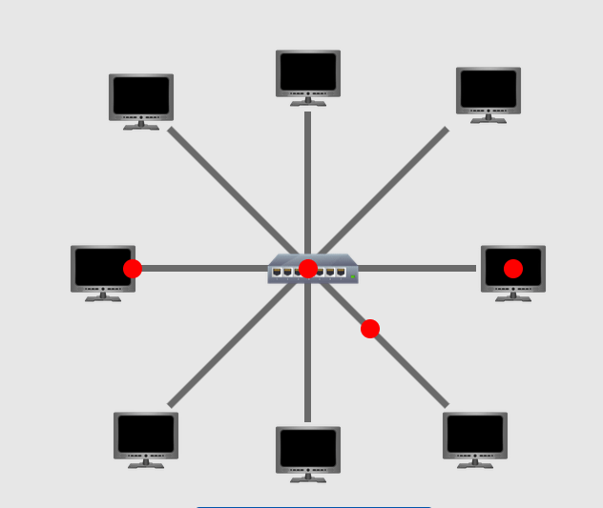
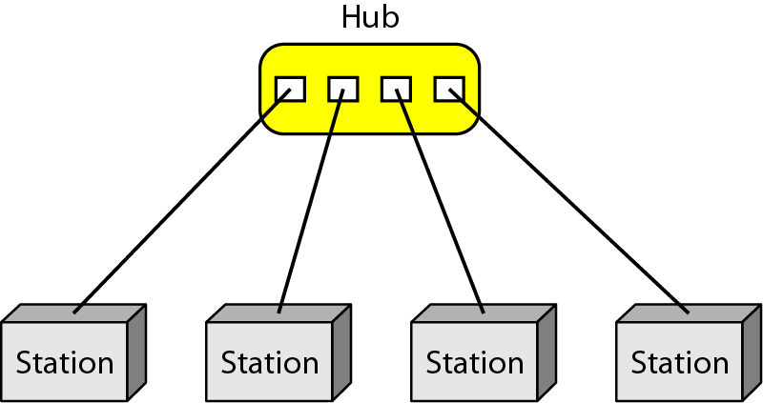
Star Topology
Each device has dedicated link with the central controller (hub).
Does not allow direct traffic between devices
  Controller relays the traffic.
Its dependency on one single point.
Example: LANs.

Slide 18
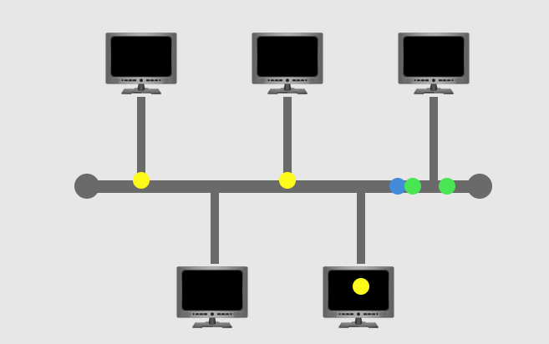
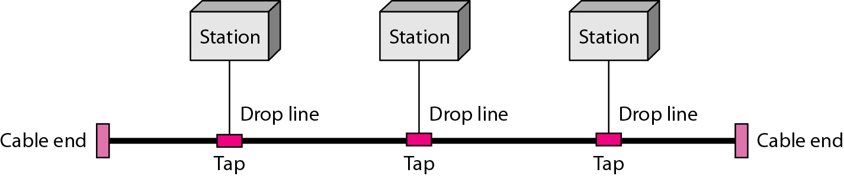
Bus Topology
Multipoint topology.
One long cable acts as a backbone to link all devices.
Nodes connected by drop lines and taps
  Drop line is connected between main line and node.
  Tap is a connector that splices or punctures into main cable to create contact with the metallic core.
Difficult to reconnect and manage faulty installation.

Slide 19
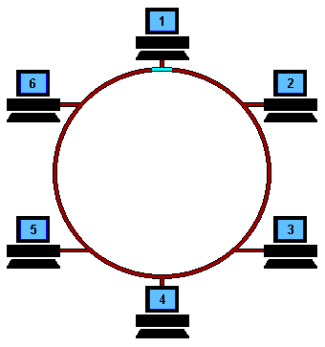
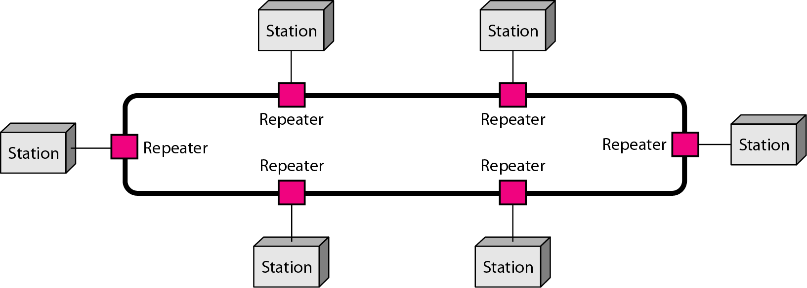
Ring Topology
Each device has a dedicated point-to-point connection with only two devices on either side of it
When a device receives a signal intended for another device, its repeater regenerates bits and passes them along.

Slide 20
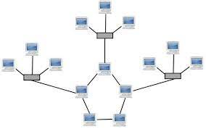
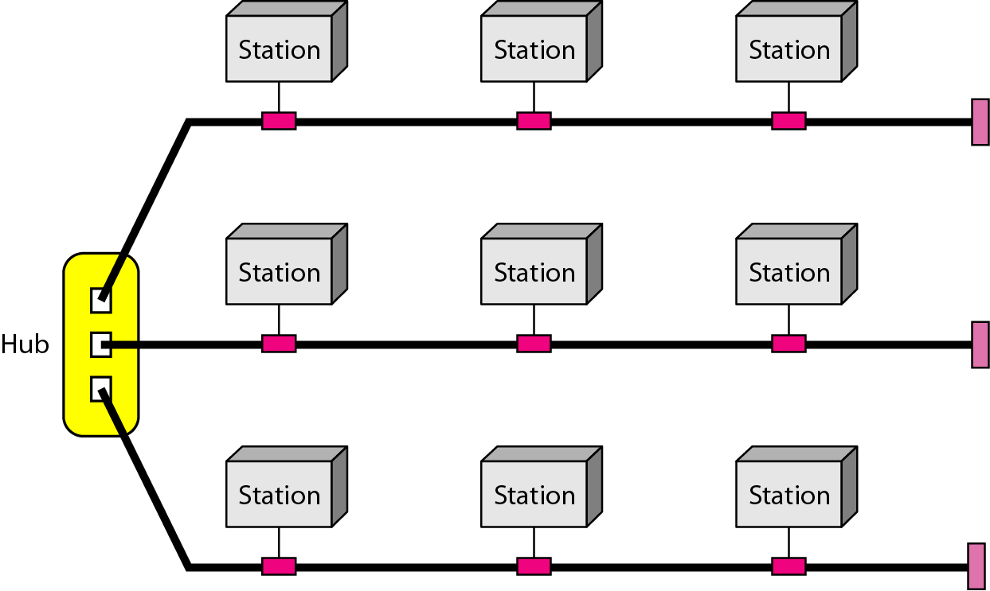
Hybrid Topology
A network can be hybrid. For example, we can have a main star topology with each branch connecting several stations in a bus topology.

Slide 21
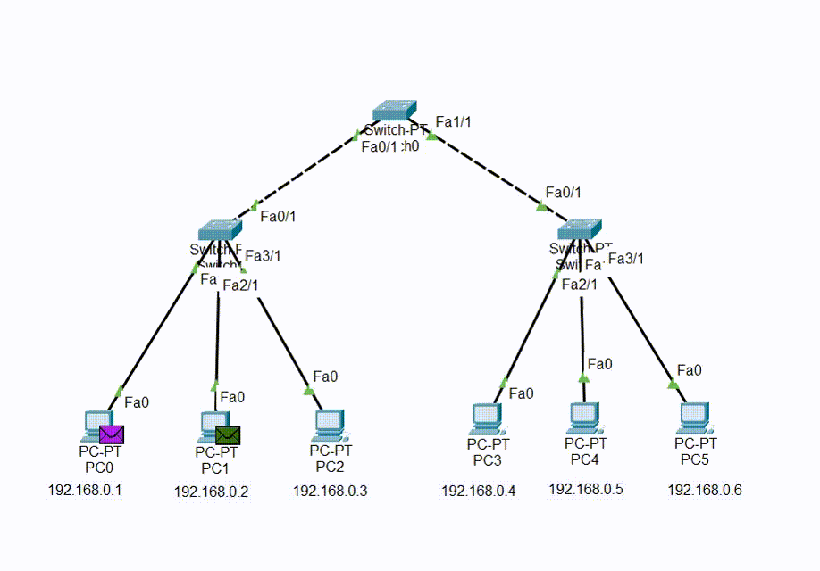
Tree Topology
A tree topology is a sort of structure in which each node is related to the others in a hierarchy.
Sometimes it is also called hierarchical topology as in this topology, all elements are arranged like the branches of a tree.
Tree topologies are commonly used to arrange data in databases and workstations in corporate networks.
Tree topology, can be viewed as a collection of star networks arranged in a hierarchy.

Slide 22
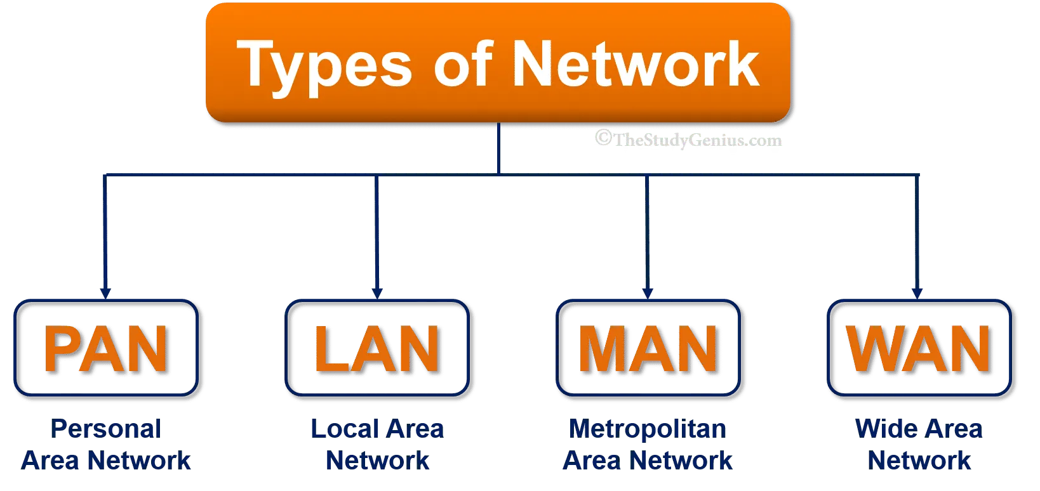
Categories of Networks

Slide 23
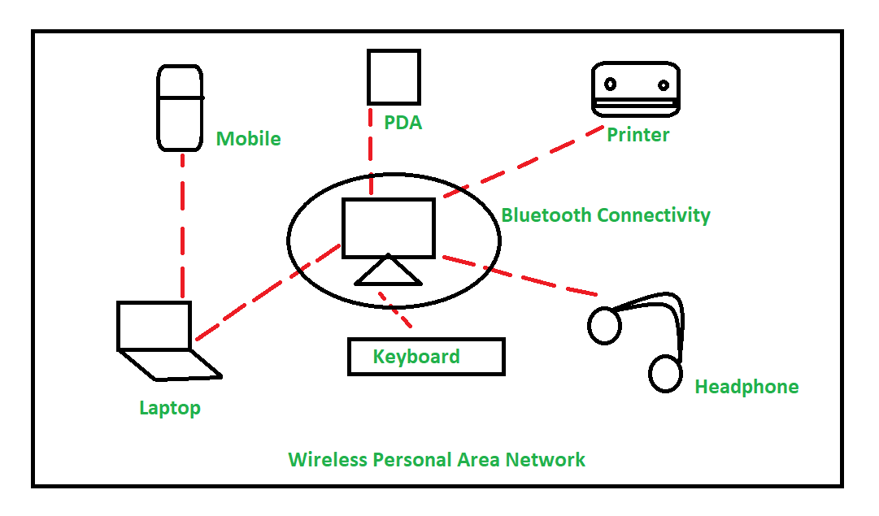
Personal Area Network
It is a network which connects devices within small range typically on the order of 10 to 100 meters.
It involves a computer, phone, tablet, printer, PDA (Personal Digital Assistant) and other and other entertainment devices like speakers, video game consoles, etc.
PAN is relatively flexible and provides high efficiency for short network ranges.

Slide 24
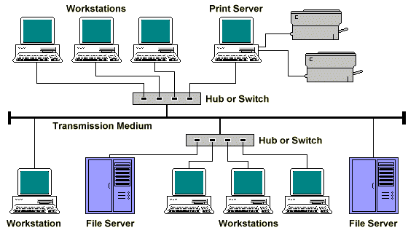
Local Area Network
Covers a small region of space, typically a single building.
The simplest form of LAN is to connect two computers together.
LAN is operated within a limited physical area such as at home, school, a single building or several buildings.
A network which consists of less than 500 interconnected devices across several buildings.
LAN is very high-speed network.

Slide 25
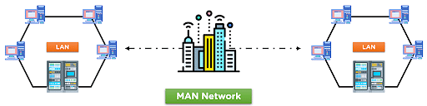
Metropolitan Area Network
The Metropolitan Area Network (MAN) is a network type that covers the network connection of an entire city or connection of a small area.
Collection of LANs with the same geographical area, for instance a city.
The area covered by the network is connected using a wired network, like data cables.
MAN often acts as a high speed network (although not as fast as LAN) to allow sharing of regional resources.

Slide 26
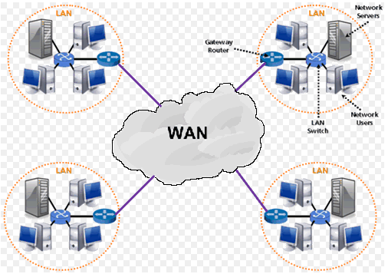
Wide Area Network
A network that covers a large geographical area comprising a region, a country, a continent or even the whole world.
WAN includes the technologies to transmit data over long distances and among different LANs and MANs.
Communication links are provided by public carriers like telephone networks, network providers, cable systems, satellites etc.
They generally have a higher bit error rate.
Typically, they have low data transfer rate and high propagation delay, i.e., they have low communication speed.

Slide 27
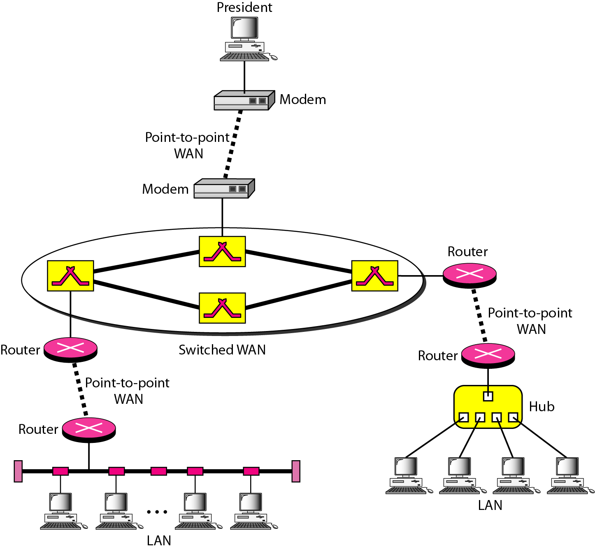
Example:

Slide 28
Switching
Switch connects at least 2 links together
Switch forwards data from one network segment to another
Types
  Circuit switched network
  Packet switched network

Slide 29
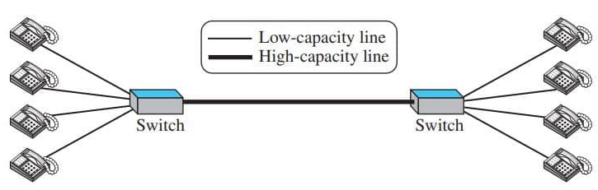
Switching
Circuit Switched network
Switch does not have storing capability; it only forwards

Slide 30
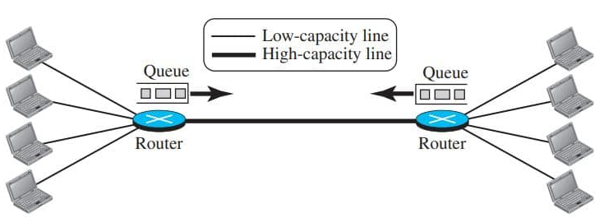
Switching
Packet Switched network
Router is used for both storing and forwarding as the packet is an independent entity

Slide 31
Internet
Internet is a collection of networks or network of networks.
Various networks such as LAN and WAN connected through suitable hardware and software to work in a seamless manner.
The basic difference between WAN and Internet is that WAN is owned by a single organization while internet is not so.

Slide 32
Accessing Internet
Using telephone networks
  Dial-up Services
  DSL Service
Using Cable Network
Using Wireless Networks
Direct Connection to the Internet

Slide 33
Questions!!!

